Slide 1
App modernization
Damir Dobric
Lead Software Architect at daenet GmbH
Microsoft Regional Director
Azure Most Valuable Professional
Proctor:
Edin Mulic
Senior Software Architect at daenet
https://damirdobric.me/

Slide 2
App modernization
Edin Mulic
Senior Software Architect at daenet
Proctor:
Damir Dobric
Lead Software Architect at daenet GmbH
Microsoft Regional Director
Azure Most Valuable Professional
https://damirdobric.me/
Notes:
Sich selbst und daenet kurz vorstellen
MS Partner, sitz in Frankfurt, ca. 15 MA, gegründet Ende 90-ger
Maßgeschneiderte SW Lösungen in MS Umfeld
Sehr viele Cloud Projekte
Neben Modernization Projekten tun wir natürlich die SW Lösungen von Anfang an designen und umsetzen
Neben klassischn Server-Client Anwendungen auch viele System Integration Projekte, IoT aber auch Projekte die in die Richtung KI gehen.

Slide 3
App modernization
Edin Mulic
Senior Software Architect at daenet GmbH
Notes:
Sich selbst und daenet kurz vorstellen
MS Partner, sitz in Frankfurt, ca. 15 MA, gegründet Ende 90-ger
Maßgeschneiderte SW Lösungen in MS Umfeld
Sehr viele Cloud Projekte
Neben Modernization Projekten tun wir natürlich die SW Lösungen von Anfang an designen und umsetzen
Neben klassischn Server-Client Anwendungen auch viele System Integration Projekte, IoT aber auch Projekte die in die Richtung KI gehen.

Slide 4
Modernization Trends
60%
80%
>500M
Public Cloud Momentum
By 2025, 60% of enterprise IT infrastructure spending will be allocated to public cloud; and a quarter of enterprise IT applications will run on public cloud services.¹
Shift to Cloud-Native
By 2023, 80% of workloads will shift to or be created with containers/microservices, reducing per-app infrastructure needs by 60%, while driving a 70% improvement in digital service resiliency.²
Industry Apps Explosion
By 2023, over 500 million digital apps and services will be developed and deployed using cloud-native approaches, most of those targeted at industry specific digital transformation use cases.³
Sources: ^{1, 2} IDC | ³ RightScale

Slide 5
App modernization
Edin Mulic
Senior Software Architect at daenet GmbH
Notes:
Sich selbst und daenet kurz vorstellen
MS Partner, sitz in Frankfurt, ca. 15 MA, gegründet Ende 90-ger
Maßgeschneiderte SW Lösungen in MS Umfeld
Sehr viele Cloud Projekte
Neben Modernization Projekten tun wir natürlich die SW Lösungen von Anfang an designen und umsetzen
Neben klassischn Server-Client Anwendungen auch viele System Integration Projekte, IoT aber auch Projekte die in die Richtung KI gehen.

Slide 6

Abstract and learning objectives
In this technical design workshop, you work with a group or alone to design a solution for modernizing legacy on-premises applications and infrastructure by leveraging cloud services.
The goal: At the end of this workshop, your ability to design a modernization plan for organizations looking to move services from on-premises to the cloud will be improved.
Notes:
Interaktiver WS, F&A jederzeit
Unterlagen sind in englisch
Sich über den Hintergrund der Teilnehmer informieren.

Slide 7
AGENDA
Prepare Lab Environment
Design Session
Hands-on-Lab
Break 12:00 – 13:00
Hands-on-Lab
End of workshop 16:00
[Optional] Talk to trainer (one-to-one)
Notes:
Typical Customer Situation
Customer Needs and Objections
Technical Design
Your turn
We provide the solution and discuss it together

Slide 8
AGENDA
Typical Customer Situation
Customer Needs and Objections
Technical Design
Your turn
We provide the solution and discuss it together
Hands on lab

Slide 9
Step ZERO – Setup your Environment
You can use your Azure Subscription
OR
You can get a Lab Environment provided by MS

Slide 10

Step ZERO – Use your own subscription
Instructions
https://github.com/microsoft/MCW-App-modernization/blob/master/Hands-on%20lab/Before%20the%20HOL%20-%20App%20modernization.md
Create the RG for the lab
Register Data Migration resource provider
Execute ARM script
Execution duration: 45 minutes
Notes:
https://github.com/microsoft/MCW-App-modernization/blob/master/Hands-on%20lab/Before%20the%20HOL%20-%20App%20modernization.md

Slide 11
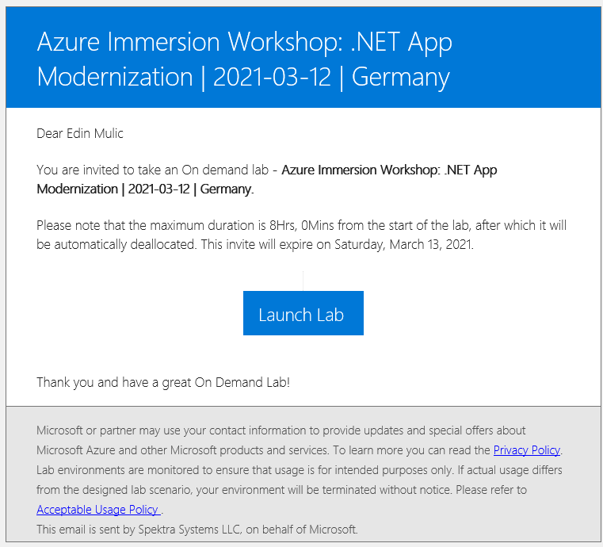
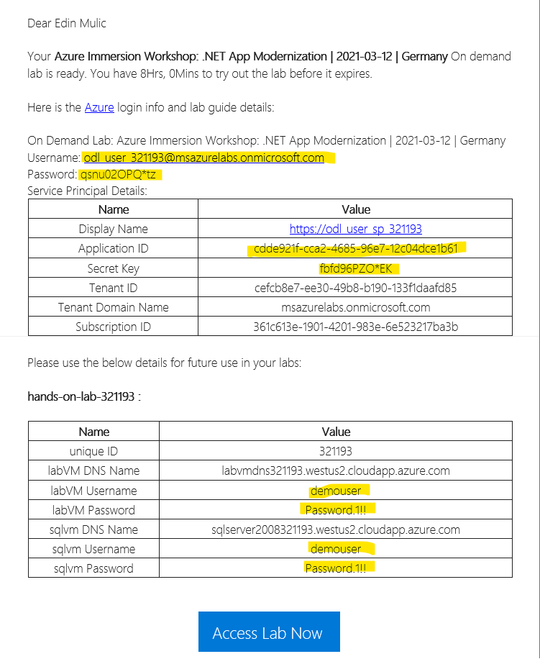
Step ZERO – Use MS Lab Environment
Sign up https://bit.ly/2Mt0bpZ Activation Code: ACTIVATE12499
Wait on Emails
Login to portal
https://portal.azure.com
Notes:
https://bit.ly/2Mt0bpZ
Activation Code: ACTIVATE12499
https://portal.azure.com

Slide 12

Customer situation
Parts Unlimited is an online auto parts store.
Its mission is to make buying vehicle replacement parts easy for consumers and professionals.
Notes:
Parts Unlimited is an online auto parts store. Founded in Spokane, WA, in 2008, they are providing both genuine OEM and aftermarket parts for cars, sport utility vehicles, vans, and trucks, including new and remanufactured complex parts, maintenance items, and accessories. Its mission is to make buying vehicle replacement parts easy for consumers and professionals.
2008 gegründet, 14 Stores, 12.000qm Verteilungszentrum, Umsatz 11Mio, Kundschaft 40% Profis + 60% Hobby

Slide 13
Customer situation - 2
A Windows Server 2019 hosting the web commerce
A SQL Server 2008 R2 hosting the website.
On-premises servers maintained by a hardware technician and a system administrator.
Out of business software vendor.
Small team with only two software engineers.
Notes:
On-Prem, gehostet in dem Verteilungszetrum.
Web App .NET Core 2.2.207 (Support abgelaufen 2019, Upgrade Versuch gescheitert) auf IIS und Windows Server 2019
Backend ist MS SQL Server 2008 R2 SP3, auf Windows Server 2008 R2 SP1.
Das IT-Team besethend aus 4 MA (2 Admins + 2 Developers) sitzt auch im Verteilungszentrum.
Die Firma die die Lösung ursprünglich umgesetzt hat, gibt es nicht mehr
Developer meiden Änderungen, da sie nur in der PROD Umgebung getestet werden können.
Dieployment Nachts über VS direkt zu PROD -> menschliche Fehler mit Betreibsauswirkungen + Belastung des Teams
Technischer Support ist nach Indonesien outgesorced worden
Marketing Investitionen geplant, um den Umsatz zu steigern.
Allerdings seit Covid-19 Performanzprobleme mit der SW, daher Investitionen zurückgestellt!
Betriebskosten für Hardware, Wartung, Updates und Lizenzen reduzieren.

Slide 14
Customer needs
Assess Migration to Azure
Migrate to Azure
Migrate to managed services
Ability to scale against unexpected load
Testing-in-production issues
DevOps Introduction
Scalable Order Processing System
Performance Monitoring

Slide 15

Customer objections
Our developers were not able to migrate our .NET Core 2.2 application to a more recent version. Should we expect a steep upgrade path with every new version?
When a .NET Core version is EoL (End-of-Life), does that mean we cannot host our solution in Azure?
We hear a lot about Kubernetes. What is the difference between App Services and Kubernetes?
We have plans to scale to Mexico and Brazil. Anything we should be worried about while moving to Azure?

Slide 16
Step 1: Review the customer case study
https://github.com/microsoft/MCW-App-modernization/blob/master/Whiteboard%20design%20session/WDS%20student%20guide%20-%20App%20modernization.md
Outcome
Analyze your customer needs.
Timeframe
15 minutes
Notes:
https://github.com/microsoft/MCW-App-modernization/blob/master/Whiteboard%20design%20session/WDS%20student%20guide%20-%20App%20modernization.md
Trainer Guide: https://github.com/microsoft/MCW-App-modernization/blob/master/Whiteboard%20design%20session/WDS%20trainer%20guide%20-%20App%20modernization.md

Slide 17
Step 2: Design the solution
Outcome
Design a solution and prepare to present the solution to the target customer audience in a 15-minute chalk-talk format.
Timeframe
60 minutes
Business needs (10 minutes) | Respond to questions outlined in your guide and list the answers on a flipchart.
Design (35 minutes) | Design a solution for as many of the stated requirements as time allows. Show the solution on a flipchart.
Prepare (15 minutes) | Identify any customer needs that are not addressed with the proposed solution. Identify the benefits of your solution. Determine how you will respond to the customer’s objections. Prepare for a 15-minute presentation to the customer.
Notes:
1. Who should you present this solution to? Who is your target customer audience? Who are the decision-makers?
- Business- + Technologie- Entscheidungsträger. In der Regel Geschäftsführung +der leitende MA. Selten Developer die dan nach oben weiter berichten
- Daher Fokus auf Businessvorteile und Kostenersparnis setzen.
2. What customer business needs do you need to address with your solution?
- Skalierbarkeit, Kosten (Betreib + Erweiterbarkeit), Ausfallsicherheit/Fehlerminimierung

Slide 18
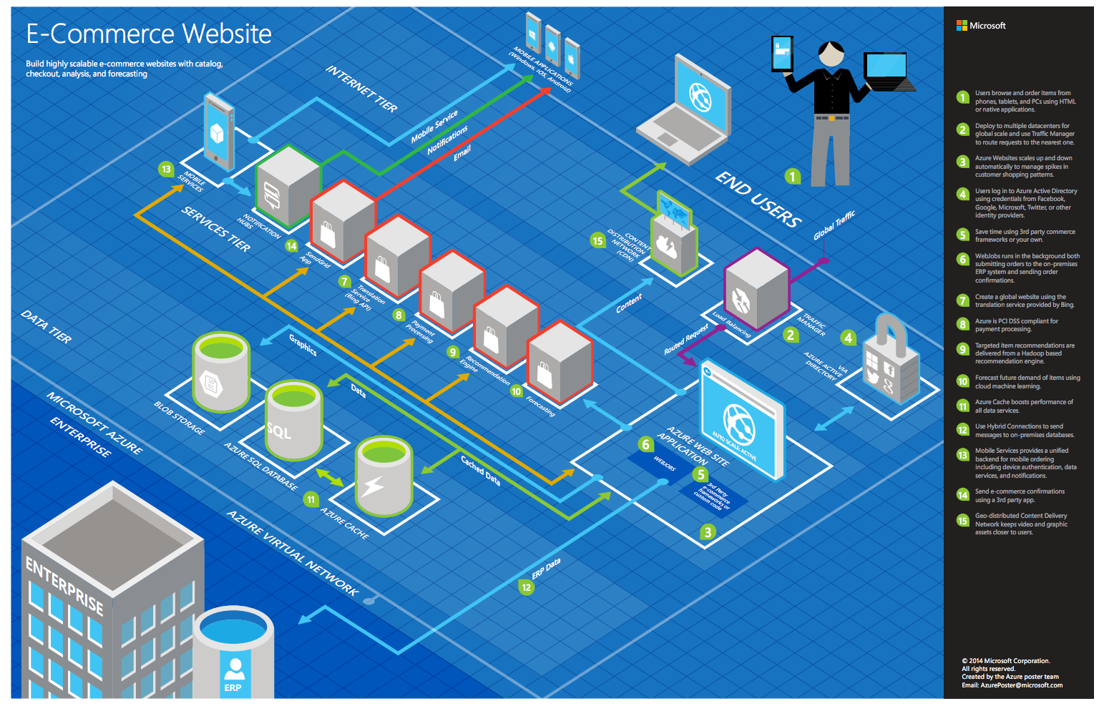
Common scenarios
Notes:
This is a diagram of a common architecture for this type of scenario, that you can draw inspiration from. You will find this diagram within the learner guide.

Slide 19
Step 3: Present the solution
Outcome
Present a solution to the target customer in a 15-minute chalk-talk format.
Timeframe
30 minutes (15 minutes for each team to present and receive feedback)
Directions
Pair with another table.
One table is the Microsoft team and the other table is the customer.
The Microsoft team presents their proposed solution to the customer.
The customer asks one of the objections from the list of objections in the case study.
The Microsoft team responds to the objection.
The customer team gives feedback to the Microsoft team.

Slide 20
Wrap-up
Outcome
Identify the preferred solution for the case study.
Timeframe
15 minutes

Slide 21

Preferred target audience
Casey Jensen, CEO, Parts Unlimited, Ltd.
The primary audience is business and technology decision-makers.
Usually, we talk to the Infrastructure Managers who report to the CIOs, or application sponsors (like a VP LOB, CMO), or to those that represent the Business Unit IT or developers that report into application sponsors.

Slide 22
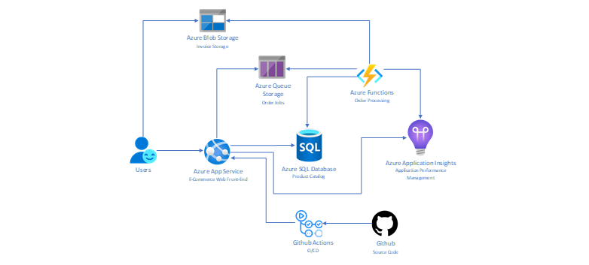
Preferred solution
Notes:
The solution begins with assessing Parts Unlimited's E-Commerce application with App Service Migration Assistant. Once the assessment succeeds, Parts Unlimited can move to migrate their e-commerce site to an App Service with the App Service Migration Assistant's help. In the case of Parts Unlimited, despite their fears of using an EoL (End-of-Life) .NET Core version, the assessment does not show any blockers. After having App Service Migration Assistant provision an App Service and migrating their application Parts, Unlimited is happy having the front-end moved to the cloud.
The next step is to migrate Parts Unlimited's SQL Server 2008 R2 database to Azure SQL Database using the Azure Database Migration Service (DMS). Using the Data Migration Assistant (DMA) assessment, Parts Unlimited determines that they can migrate into a fully-managed SQL Database service in Azure. The assessment revealed no compatibility issues or unsupported features that would prevent them from using Azure SQL Database.
For order processing, Parts Unlimited will modify its e-commerce site to submit order jobs into an Azure Storage Queue. The code change will be minimal. An Azure Function will be implemented to take the jobs from the queue and process orders, create PDF invoices for each order, and finally upload invoices into an Azure Storage Blob to be served to customers through the e-commerce site directly from blobs using SAS links.
For DevOps, Parts Unlimited will use a git repository on GitHub to host its codebase. A CI/CD pipeline will be hosted on top of GitHub Actions building and deploying the solution to a staging deployment slot in the Azure App Service. Parts Unlimited can swap slots once they are happy with the changes deployed to staging.

Slide 23
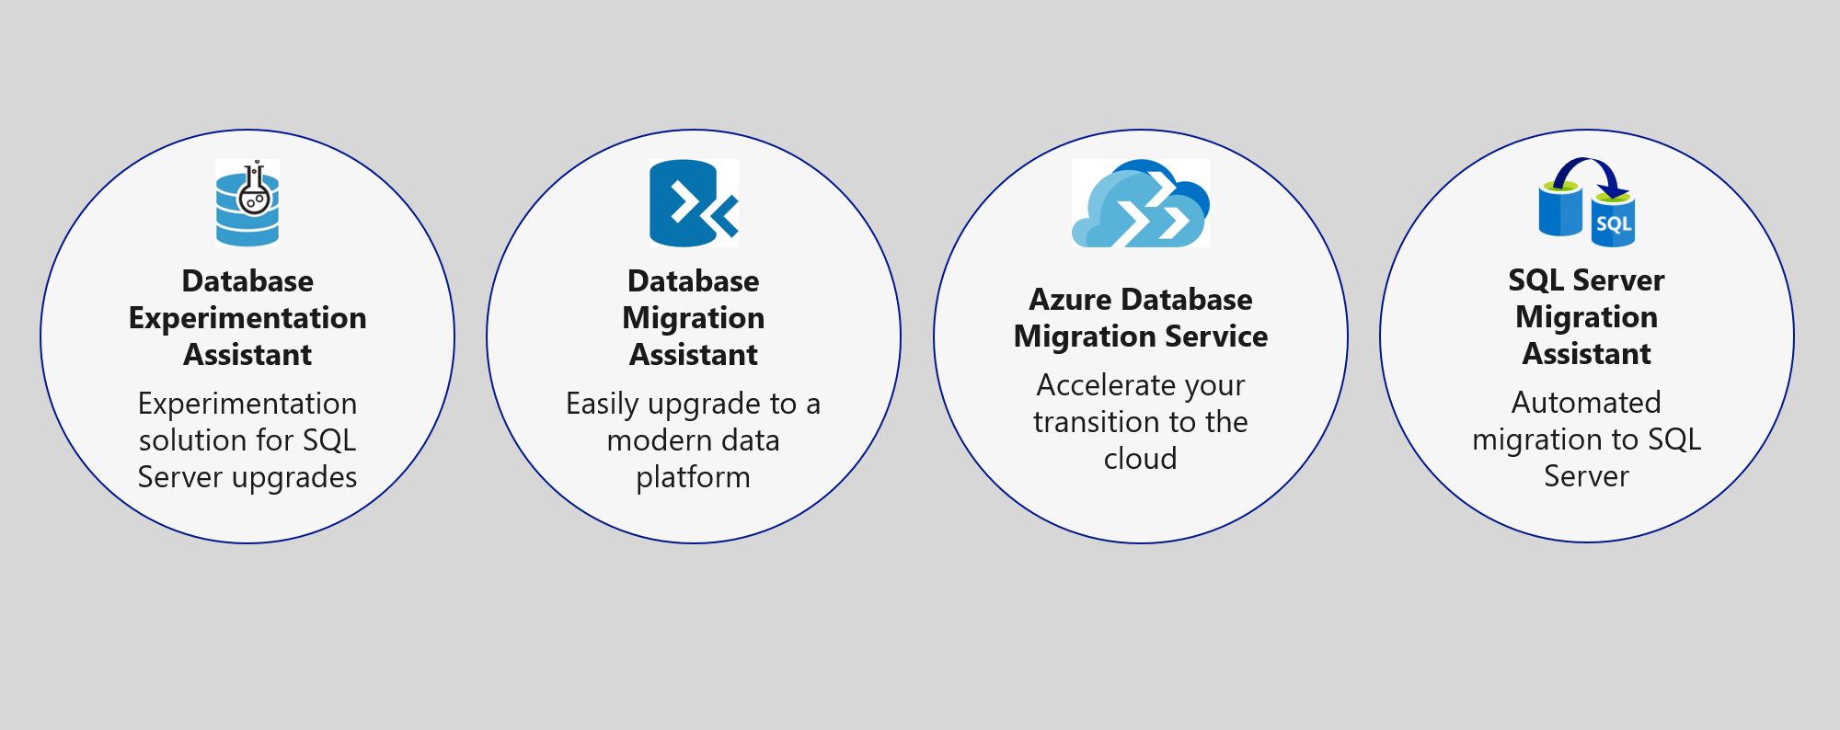
Preferred solution – Data Management
Migrate database to Azure SQL using Database Migration Service

Slide 24
Assessment and Migration
Azure Migrate provides a centralized hub to assess and migrate on-premises servers, infrastructure, applications, and data to Azure.
The App Service Migration Assistant
Azure Database Migration Service's (DMS)
Database Migration Assistant (DMA)
Database Experimentation Assistant (DEA)
Migration to a higher version of .NET
The .NET Portability Analyzer
Notes:
Azure App Service is the best solution for running ASP.NET web apps on Azure. The App Service Migration Assistant can be used to assess whether their apps have dependencies on unsupported features on Azure App Service. App Service Migration Assistant can run readiness checks and get potential remediation steps for common issues. The assistant provides step-by-step guidance for moving a web app to App Service. Parts Unlimited can use Azure Migrate to consolidate all assessment and migration projects.
The database migration should be handled using the Azure Database Migration Service's (DMS) that is part of Azure Migrate. DMS is a fully managed service designed to enable seamless migrations from multiple database sources to Azure Data platforms with minimal downtime. It provides customers with a comprehensive, highly available migration solution. The service uses the Data Migration Assistant to generate assessment reports that provide recommendations to guide you through the changes required before performing a migration. When you're ready to begin the migration process, the Azure Database Migration Service executes all of the steps necessary, following best practices as determined by Microsoft.
The Data Migration Assistant (DMA) enables you to upgrade to a modern data platform by detecting compatibility and feature parity issues that can impact an upgrade or migration to your target version of SQL Server or Azure SQL Database. DMA also provides recommendations on performance and reliability improvements you can make once your databases have been migrated to your target environment. It allows you to move your schema, data, and uncontained objects (SQL Agent jobs, SSIS packages, roles, users, and logins) from your source server to your target server.
The Database Experimentation Assistant (DEA) is an A/B testing solution for SQL Server upgrades. It assists in evaluating specific workloads against a targeted version of SQL Server or SQL Database. DEA is not a migration tool but can be used to help determine the appropriate target version of SQL Server or SQL Database for migrations.
The App Service Migration Assistant indicates no issues for Parts Unlimited to move to Azure. However, it is strongly suggested to move to a supported version post-migration. The .NET Portability Analyzer can be used to assess how much work is required for a migration.

Slide 25
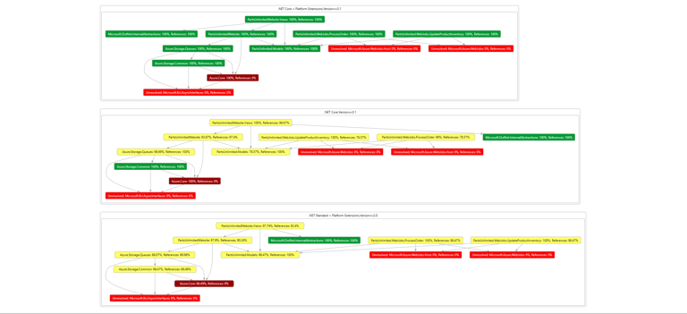
The .NET Portability Analyzer
Notes:
The .NET Portability Analyzer is a tool that analyzes assemblies and provides a detailed report on .NET APIs that are missing for the applications or libraries to be portable on your specified targeted .NET platforms. The Portability Analyzer is offered as a Visual Studio Extension, which analyzes one assembly per project, and as an ApiPort console app, which analyzes assemblies by specified files or directory. Here you see a DGML file showing dependencies in the Parts Unlimited web application.

Slide 26
Modernization
Azure Functions consumption plan for Serverless Order Processing
Application Insights for Performance Monitoring
Serverless helps with unexpected spikes in load for SQL Server
Notes:
Azure Functions can be used to develop a solution that can ingest order jobs from an Azure Storage Queue and process orders at scale. The only code change required on the web application would relate to adding jobs into the queue. Azure Functions consumption plan provides instances of the Functions host that are dynamically added and removed based on incoming events. The consumption plan is aligned with Parts Unlimited's requirements. Parts Unlimited pays only when the functions are running, and the platform scales automatically, even during periods of high load. For PDF generation Function will be using headless Chromium that only works on Linux. Parts Unlimited can deploy their function to Linux Consumption Plans to make their solution work.
Application Insights, a feature of Azure Monitor, is an extensible Application Performance Management (APM) service for developers and DevOps professionals. Parts Unlimited can use it to monitor their e-commerce application live. Application Insights will automatically detect performance anomalies and include powerful analytics tools to help developers diagnose issues and understand what users actually do with their app. It's designed to help developers continuously improve performance and usability.
Serverless is a compute tier for single databases in Azure SQL Database that automatically scales compute based on workload demand and bills for the amount of compute used per second. The serverless compute tier also automatically pauses databases during inactive periods when only storage is billed and automatically resumes databases when activity returns. The serverless compute tier for single databases in Azure SQL Database is parameterized by a compute autoscaling range and an auto-pause delay. The configuration of these parameters shapes the database performance experience and compute cost.

Slide 27
DevOps
Azure App Service Deployment Slots
GitHub Actions
Azure App Service Deployment Center
Notes:
When you deploy your web app to Azure App Service, you can use a separate deployment slot instead of the default production slot. Deployment slots are live apps with their hostnames. App content and configuration elements can be swapped between two deployment slots, including the production slot. Deploying your application to a non-production slot helps you validate app changes in a staging deployment slot before swapping it with the production slot. After a swap, the slot with the previously staged app now has the previous production app. If the changes swapped into the production slot aren't as you expect, you can immediately perform the same swap to get your "last known good site" back.
GitHub Actions is an excellent place to automate, customize, and execute your software development workflows right in your repository with. Developers can build, test, and deploy their code right from GitHub. App Service comes with a Deployment Center functionality that streamlines GitHub integration. Parts Unlimited can use the Deployment Center to create a CI/CD pipeline targeting a staging App Service Deployment Slot.

Slide 28
Preferred objection handling
Our developers were not able to migrate our .NET Core 2.2 application to a more recent version. Should we expect a steep upgrade path with every new version?
When a .NET Core version is EoL (End-of-Life), does that mean we cannot host our solution in Azure?
We hear a lot about Kubernetes. What is the difference between App Services and Kubernetes?
We have plans to scale to Mexico and Brazil. Anything we should be worried about while moving to Azure?
Notes:
- We have [The .NET Portability Analyzer](https://docs.microsoft.com/en-us/dotnet/standard/analyzers/portability-analyzer) that can be used to assess how much work is required for a migration. We know projects that can migrate with a single configuration change and others who had to do some work based on the application's complexity and code dependencies. The .NET Portability Analyzer can give you a good idea of how much effort is required to migrate to a newer version, including an assessment of all your code dependencies.
- When a .NET Core version is EoL (End-of-Life), does that mean we cannot host our solution in Azure?
- After the End-Of-Lime time, .NET Core patch updates will no longer be available for .NET Core 2.2. Your application will still run. .NET Core 2.2 was released as a non-LTS (Long Term Support) release. A non-LTS ("Current") release is supported for three months after the next release. For hosting applications that you do not intend to update often, we suggest LTS releases. LTS releases include features and components that have been stabilized, requiring few updates over a longer support release lifetime. The supported upgrade path from .NET Core 2.2 is via .NET Core 3.1. .NET Core 3.1 is released December 3, 2019, as a long-term support release.
- Azure is an open cloud that offers multiple choices. We suggest App Service if you have a single or a few back-end services in an N-Tier architecture. Azure Kubernetes Services is a better fit for Cloud-Native (Microservices) design.
- Azure has 60+ regions, more than any other cloud provider. Our physical infrastructure comprises 160+ physical datacenters arranged into regions and linked by one of the world's largest interconnected networks. We have services such as Azure Traffic Manager for DNS-based traffic load balancing, Azure Front Door, a global, scalable entry-point that uses the Microsoft global edge network to create fast, secure, and widely scalable web applications, and Azure CosmosDB, a globally-distributed planet-scale database service. All these services are ready for implementation and used by millions of customers every day. We would be more than happy to help Parts Unlimited scale its operations globally.

Slide 29
Customer quote
“Microsoft has done a brilliant job with the technology they have put into the cloud. We are confident that our Azure-hosted applications are now scalable and resilient, and our team has all the tools they need to be more productive in modernizing our e-commerce platform. We could not be happier running Parts Unlimited on Azure.”
Casey Jensen, CEO, Parts Unlimited, Ltd.

Slide 30
App modernization
Hand-On-Lab https://github.com/microsoft/MCW-App-modernization/blob/master/Hands-on%20lab/HOL%20step-by-step%20-%20App%20modernization.md
Notes:
https://github.com/microsoft/MCW-App-modernization/blob/master/Hands-on%20lab/HOL%20step-by-step%20-%20App%20modernization.md

Slide 31
All content is on GitHub
https://github.com/microsoft/MCW-App-modernization
Notes:
https://github.com/microsoft/MCW-App-modernization

Slide 32

Survey
https://forms.office.com/Pages/ResponsePage.aspx?id=v4j5cvGGr0GRqy180BHbR4UXtppiuOFNvOnZh_G-wrFUOElGOFcyWFZXVzRISVVFRDhMTDQyOFNJQiQlQCN0PWcu
Workshop Engagement ID: SRDEM56654
Notes:
https://forms.office.com/Pages/ResponsePage.aspx?id=v4j5cvGGr0GRqy180BHbR4UXtppiuOFNvOnZh_G-wrFUOElGOFcyWFZXVzRISVVFRDhMTDQyOFNJQiQlQCN0PWcu

Slide 33
THANK YOU ☺
Damir Dobric
Lead Software Architect at daenet GmbH
Microsoft Regional Director
Azure Most Valuable Professional
Proctor:
Edin Mulic
Senior Software Architect at daenet

Slide 34
THANK YOU ☺
Edin Mulic
Senior Software Architect at daenet

Slide 35
THANK YOU ☺
Edin Mulic
Senior Software Architect at daenet
Proctor:
Damir Dobric
Lead Software Architect at daenet GmbH
Microsoft Regional Director
Azure Most Valuable Professional
https://damirdobric.me/

Slide 36
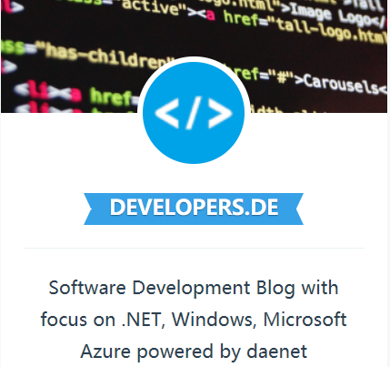

Besuchen Sie unser Azure Meetup www.meetup.com/Azure-Meetup-Frankfurt/
Besuchen Sie unseren Software Development Blog www.developers.de

Slide 38

Customer situation
Contoso, Ltd. provides a full range of long-term insurance services to help underinsured people.
They are trying to cope with being overloaded due to faster-than-expected growth.
Notes:
Contoso Ltd. is a new company in a very old business. Founded in Auckland, New Zealand, in 2005, by senior life insurance executives, the ambitious new company provides a full range of long-term insurance services to help people who are underinsured.
Almost from the start, the company grew far faster than anticipated. An avalanche of business meant that the original processes created to manage policy documentation became overloaded. Employees struggled to cope, even as the headcount rose from five to 110 during the first year.

Slide 39

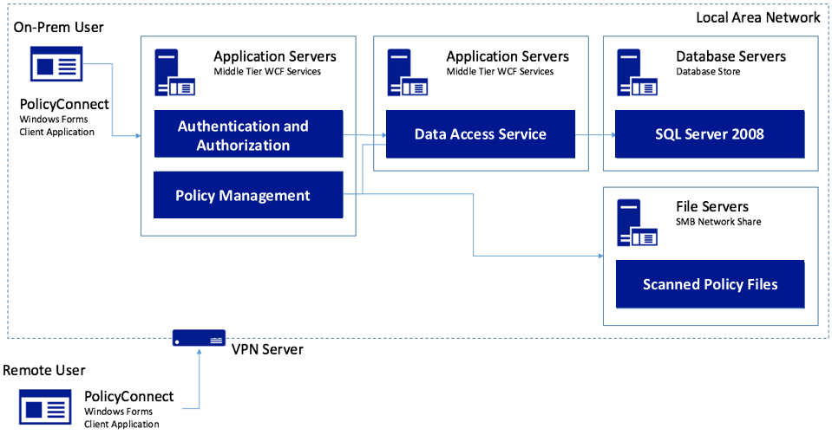
Customer situation
Contoso, Ltd. created a custom Windows Forms app called PolicyConnect for their employees to manage policy holder information.
Their data is stored in a SQL Server 2008 database, and a file server on their local area network.
Notes:
Contoso Ltd. implemented PolicyConnect, a custom Windows Forms application used by their staff to input key metadata that includes policy holder information such as insured amount, beneficiary, policy type, and any deductible and out of pocket requirements.
Contoso employees access this application which ultimately stores its data in a SQL Server 2008 database, and a file server on their local area network.

Slide 40



Customer situation
Employees rely on email as a workflow engine for document management tasks.
Would like options to gain insights without requiring custom development each time.
Wants to make policy holder system available through web and mobile applications without VPN.
Notes:
Contoso employees rely on email as a workflow engine relative to the document management tasks. They are using Office 365.
Executive leadership have frequent challenges in gauging productivity and throughput given the manual workflow—they feel that are blocked in quickly getting to the insights they need because each new question seems to need more custom development.
Wants to make their policy holder system available to its employees and brokers via web and mobile applications without requiring VPN, and store policies in cloud storage for retrieval via the new apps.
They would like to migrate their SQL Server based database to SQL Database

Slide 41




Customer situation
We would like to make sure our database isn’t overtaxed, show a dashboard with user statistics, allow non-developers in other departments to make mobile apps, and improve security by protecting application secrets.
Can you help us do this?
Notes:
Want to ensure they employ best practices for mitigating the impact of repeated querying of the database
Looking to implement a scoreboard of sorts that tracks the most active users in a 24-hour period, as well as approximate the number of operations that user performed with the system in perpetuity
Want to make sure they have a streamlined way for internal departments to quickly build their own apps to automate time saving micro-processes without having to involve the PolicyConnect development team or ideally, even developers
Improve security by externalizing secrets such as connection strings from the web apps and APIs, and storing them in an encrypted location accessible only to authorized services
Contoso has multiple development teams and is concerned about duplication of effort and change management as they move more business logic to APIs. They also are considering opening a subset of APIs to a network of affiliated partners.

Slide 42






Customer needs
Modernize our architecture
Go mobile
Enable non-developer employees to create apps
Improve management of app secrets
Add cognitive search
Reduce server management tasks
Migrate to fully-managed SQL database service
Add caching to our solution

Slide 43
Customer objections
How can we automate our processes?
Will Power Automate (aka Microsoft Flow) replace Logic Apps?
Is there really a way to securely store application secrets in the cloud?
We won’t have all of the SQL features available to us in the cloud.
Our API inventory will grow, and we are concerned about how to best manage that.
Wants to understand how choose correct .NET framework

Slide 44
Step 1: Review the customer case study
https://github.com/daenetCorporation/MCW-App-modernization/blob/master/Whiteboard%20design%20session/WDS%20student%20guide%20-%20App%20modernization.md
Outcome
Analyze your customer needs.
Timeframe
15 minutes
Notes:
https://github.com/daenetCorporation/MCW-App-modernization/blob/master/Whiteboard%20design%20session/WDS%20student%20guide%20-%20App%20modernization.md https://github.com/microsoft/MCW-App-modernization/blob/master/Whiteboard%20design%20session/WDS%20student%20guide%20-%20App%20modernization.md
Trainer Guide: https://github.com/microsoft/MCW-App-modernization/blob/master/Whiteboard%20design%20session/WDS%20trainer%20guide%20-%20App%20modernization.md

Slide 45
Common scenarios
Notes:
This is a diagram of a common architecture for this type of scenario, that you can draw inspiration from. You will find this diagram within the learner guide.

Slide 46
Step 2: Design the solution
Outcome
Design a solution and prepare to present the solution to the target customer audience in a 15-minute chalk-talk format.
Timeframe
60 minutes
Business needs (10 minutes) | Respond to questions outlined in your guide and list the answers on a flipchart.
Design (35 minutes) | Design a solution for as many of the stated requirements as time allows. Show the solution on a flipchart.
Prepare (15 minutes) | Identify any customer needs that are not addressed with the proposed solution. Identify the benefits of your solution. Determine how you will respond to the customer’s objections. Prepare for a 15-minute presentation to the customer.

Slide 47
Step 3: Present the solution
Outcome
Present a solution to the target customer in a 15-minute chalk-talk format.
Timeframe
30 minutes (15 minutes for each team to present and receive feedback)
Directions
Pair with another table.
One table is the Microsoft team and the other table is the customer.
The Microsoft team presents their proposed solution to the customer.
The customer asks one of the objections from the list of objections in the case study.
The Microsoft team responds to the objection.
The customer team gives feedback to the Microsoft team.

Slide 48
Wrap-up
Outcome
Identify the preferred solution for the case study. Identify solutions designed by other teams.
Timeframe
15 minutes

Slide 49
Preferred target audience
Charlene Mathis, General Manager, Contoso Ltd
The primary audience is business and technology decision makers.
Usually we talk to the Infrastructure Managers who report into the CIOs, or to application sponsors (like a VP LOB, CMO) or to those that represent the Business Unit IT or developers that report into application sponsors.

Slide 50
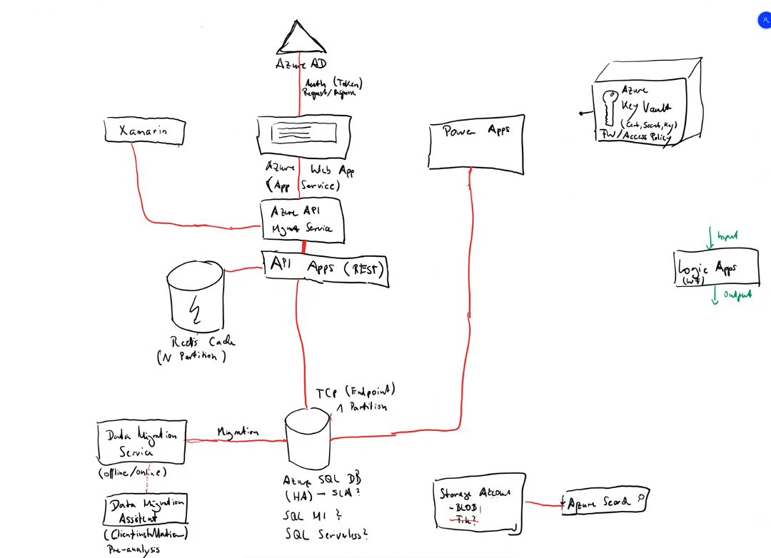

Slide 51
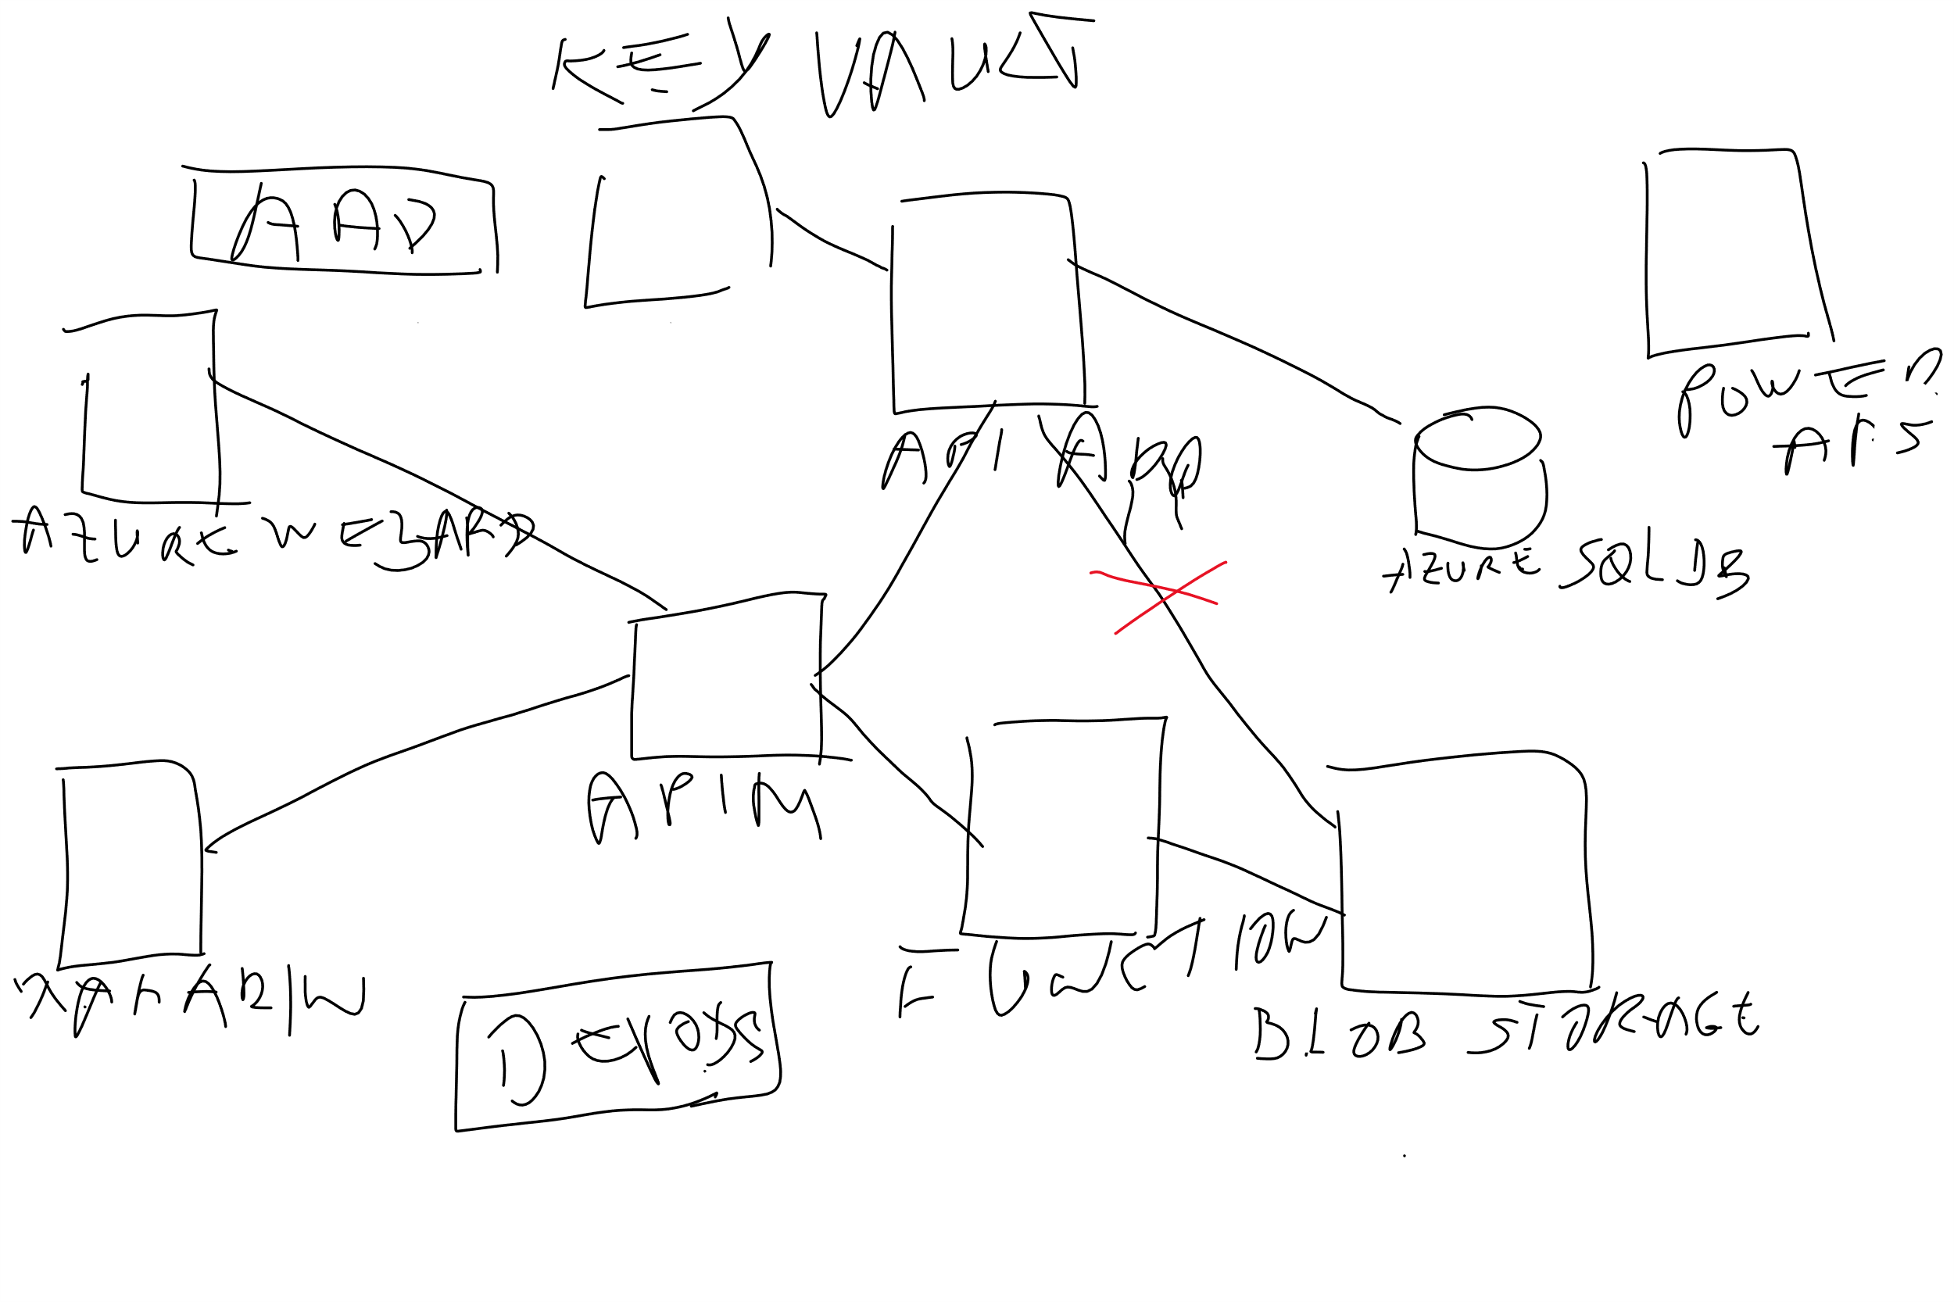

Slide 52
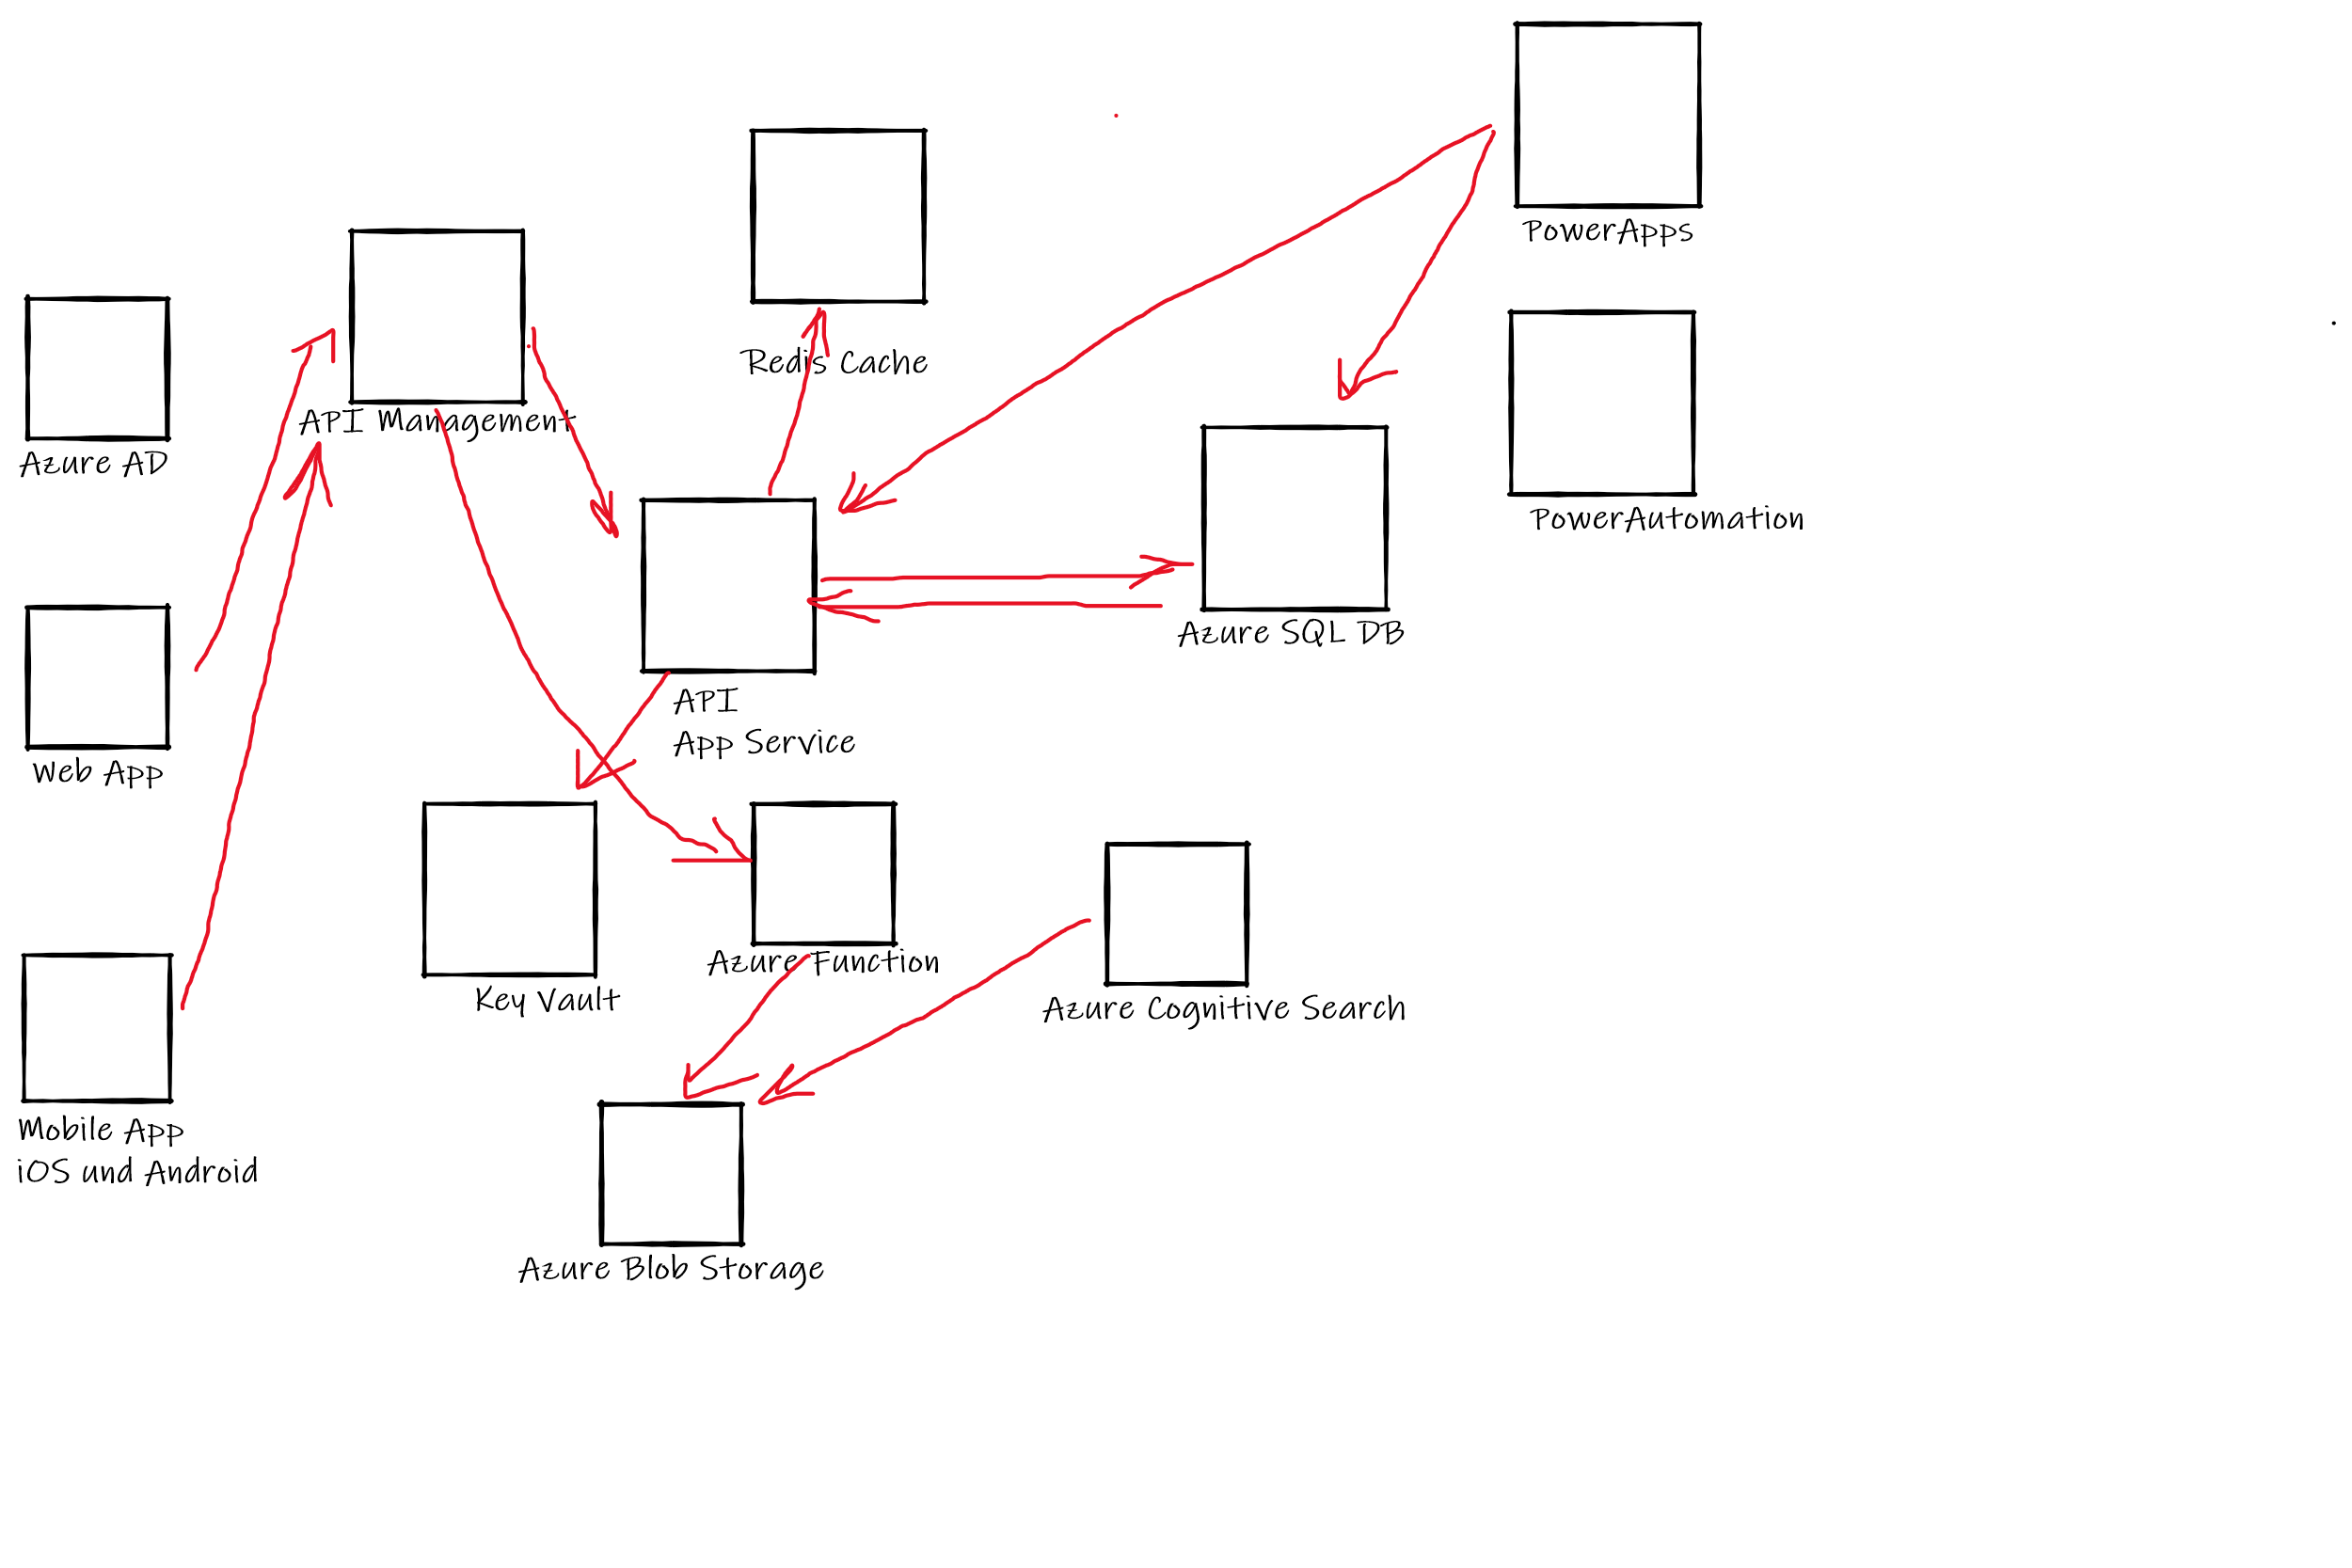

Slide 53
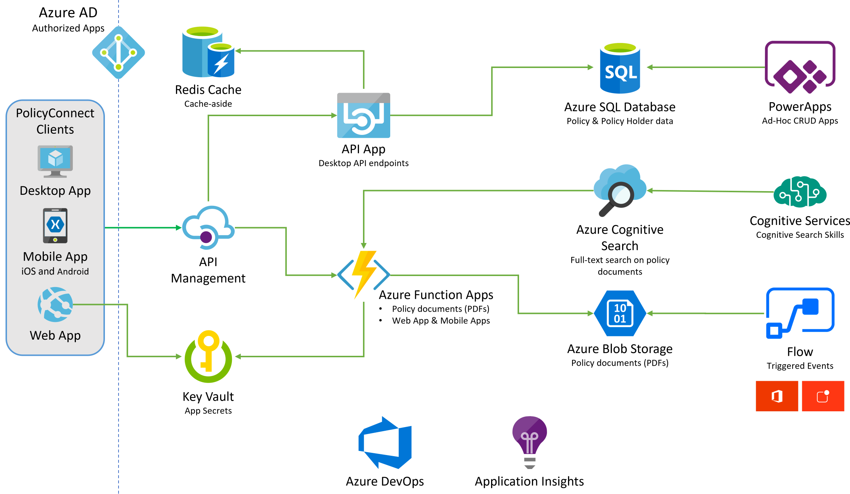
Preferred solution
Notes:
https://github.com/microsoft/MCW-App-modernization/blob/master/Whiteboard%20design%20session/WDS%20trainer%20guide%20-%20App%20modernization.md#preferred-solution The solution begins with migrating Contoso's SQL Server 2008 R2 database to Azure SQL Database using the Azure Database Migration Service. After performing an assessment using the Data Migration Assistant, Contoso was able to determine that there were no compatibility issues or unsupported features to prevent them from migrating into a fully-managed SQL database service in Azure. Next, the web and API apps are migrated into Azure App Services. In addition, mobile apps, built for Android and iOS using Xamarin, are created to provide access to PolicyConnect. The website, hosted in a Web App, provides the user interface for browser-based clients, whereas the Xamarin Forms-based apps provide the UI to mobile devices. Both the mobile app and website rely on web services hosted in a Function App, which sits behind API Management. An API App is also deployed to host APIs for the legacy Windows Forms desktop application. Light-weight, serverless APIs are provided by Azure Functions and Azure Functions Proxies to provide access to the database and policy documents stored in Blob Storage. Azure API Management is used to create an API Store for development teams and affiliated partners. Sensitive configuration data, like connection strings, are stored in Key Vault and accessed from the APIs or Web App on demand so that these settings never live in their file system. The API App uses the Azure Redis Cache to implement the cache aside pattern, caching data as it is retrieved from SQL Database. A full-text cognitive search pipeline is used to index policy documents in Blob Storage. Cognitive Services are used to enable search index enrichment using cognitive skills in Azure Cognitive Search. PowerApps enable authorized business users to build mobile and web create, read, update, delete (CRUD) applications that interact with SQL Database and Azure Storage, while Microsoft Flow enables them to orchestrations between services such as Office 365 email and services for sending mobile notifications. These orchestrations can be used independently of PowerApps or invoked by PowerApps to provide additional logic. The solution uses user and application identities maintained in Azure AD.

Slide 54
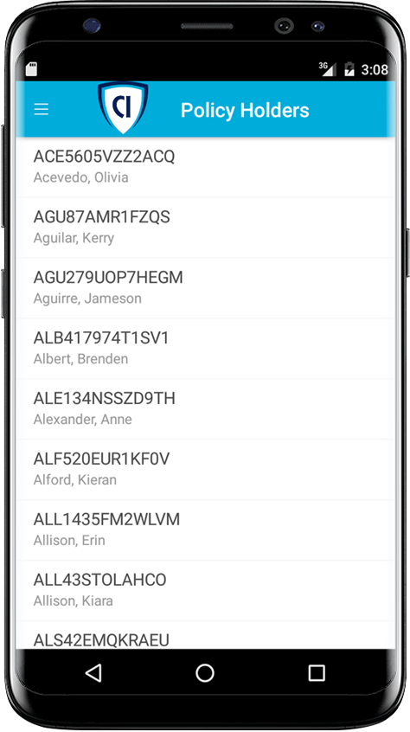
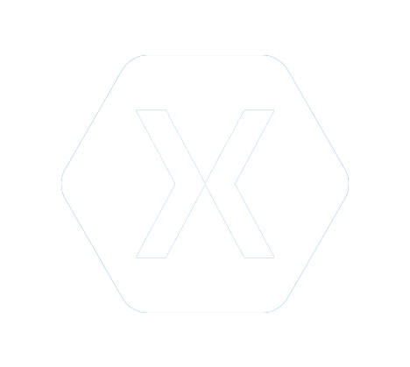


Preferred solution - 2
Mobile and Web Applications
Build mobile with Xamarin
Use an API App for the back-end
Host web site with a Web App
Use Azure Functions Proxies
Notes:
How should Contoso implement the PolicyConnect mobile app?
- Utilize Xamarin within Visual Studio
What Azure service would host the services supporting the mobile app backend? Would you suggest a Mobile App or an API App? Why?
- In this scenario, either one would work because API Apps and Mobile Apps expose the same functionality that Contoso needs to support the Web App and the APIs that are behind the Web App and the Xamarin mobile application.
What Azure service would host the web site?
- A Web App
What Azure service would provide a light weight, serverless API solution for retrieving policy documents from Azure blob storage?
- Azure Functions Proxies provide an easy way to create serverless APIs, providing a way to break large APIs into multiple function apps (as in a microservices architecture), while still presenting a single API surface for clients.

Slide 55
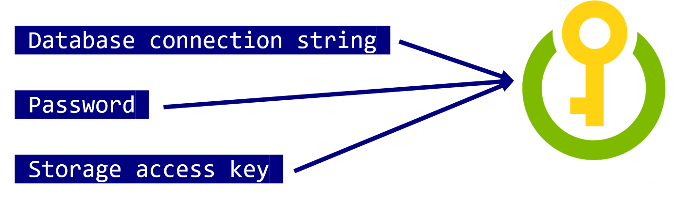
Preferred solution - 3
Mobile and Web Applications
Use Key Vault to store sensitive application secrets like database connection strings.
Notes:
How would you secure sensitive information used by the web site and APIs?
- Rather than storing sensitive application secrets like credentials and database connection strings in the web.config of the Web and API Apps, Contoso should use Key Vault to store these secrets

Slide 56
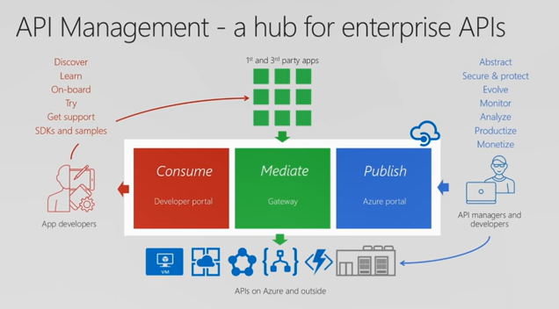

Preferred solution - 4
API Management
Contoso should use Azure API Management now to put together a proof of concept solution.
Azure API Management
Notes:
What recommendations can you make to help Contoso manage its API inventory as it grows in the future? Are there services in Azure that can provide a proof of concept *API Store* experience now and serve as path to development in the future?- Azure API Management has features to help Contoso quickly build and scale an API ecosystem and grow into the future. APIs can be organized into Product groups to provide organization and AAD integration comes out of the box. It will be relatively easy to develop new customer channels for affiliated partners and provide controlled discoverability and lifecycle management to development teams.

Slide 57
Preferred solution - 5
Data Management
Migrate database to Azure SQL using Database Migration Service

Slide 58
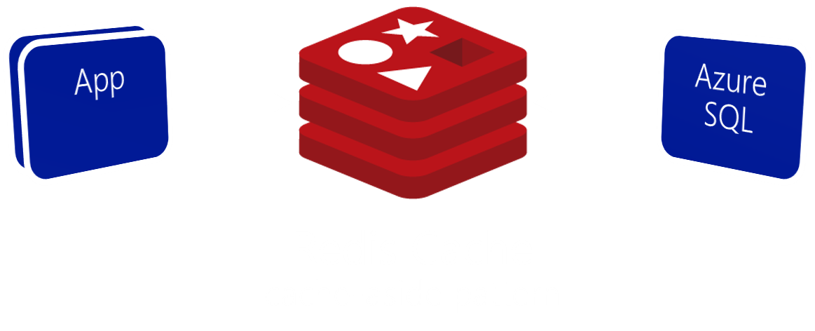
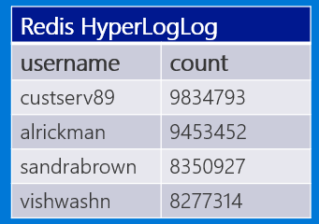
Preferred solution - 6
Data management
Use Azure Redis Cache to reduce load on database and implement scoreboards.
Scoreboard using HyperLogLog
Notes:
What patterns and services would you use to reduce load on the database? Implement the scoreboards?
- Use Azure Redis Cache and the cache-aside pattern.
- Check Azure Redis Cache is first on data requests. Return cached copy if exists, fetch from SQL Database if not, then save to Redis Cache.
- Scoreboards can also be implemented with Azure Redis Cache due to support for fast atomic incrementing of the values for any given string key (e.g., the key would be the username, the value the count). To reduce memory requirements for very large counts, use Redis’ HyperLogLog to store the counted value for each user key.
----------------------------------------------------------------------------------------
- In this approach, as data items are requested, the Azure Redis Cache is first checked to see if it exists there (if it is, then the cached copy is returned). Failing that, the application makes a request directly against SQL Database, but while returning the result to the client it also adds the data item into the Redis Cache.
- Scoreboards can be implemented effectively using Azure Redis Cache because of its support for fast atomic incrementing of the values for any given string key (e.g., the key would be the username, the value the count). To reduce memory requirements for very large counts (such as is possible collecting transaction counts per user in perpetuity), they could use Redis’ HyperLogLog to store the counted value for each user key. The HyperLogLog approximates the cardinality of a set the approximates the count of the number of unique items added (with an error rate less than 1%), and uses a fixed size of 12KB.

Slide 59
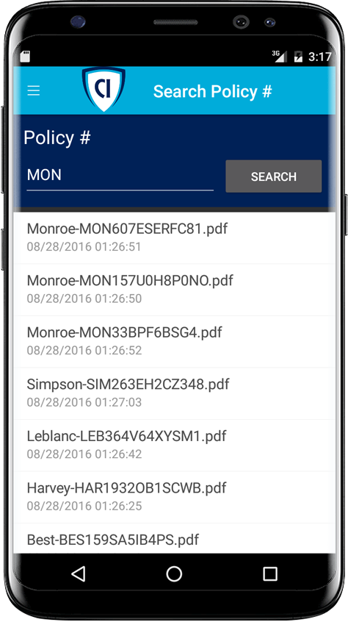

Preferred solution - 7
Search
Enable full-text search of policy documents with Azure Cognitive Search.
Azure Cognitive Search + Indexer for Azure Storage blobs
Notes:
Given their requirements, how would you enable full text search on the stored policy documents?
- Use Azure Cognitive Search and the Indexer for Azure Storage blobs.
- For files stored in Azure Storage Blobs, this indexer will full-text index PDFs, Microsoft Office Documents (DOCX, DOC, XLSX, XLS, PPTX, PPT and MSG), HTML, XML, ZIP, EML, JSON, and plain text files. They could then use the Azure Cognitive Search .NET SDK from the API App to kick off searches.

Slide 60
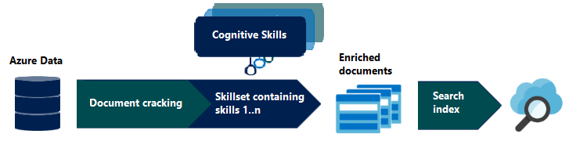
Preferred solution - 8
Search
Enrich search index with Cognitive Search

Slide 61

Preferred solution - 9
Search
Custom cognitive skills
Azure Cognitive Search + Functions

Slide 62

Preferred solution - 10
Extensibility
Enable business users to create their own internal mobile apps using PowerApps.
They can use Microsoft Flow to create ad-hoc automated processes.
Notes:
How would you enable their business users to create their own internal mobile apps that help them streamline their processes without the time and resource investment required for full scale mobile apps?
- PowerApps would enable business users at Contoso to create their own web and mobile apps that support CRUD functionality against data in SQL DB and Azure Storage Blobs.
- Microsoft Flow, which integrates with PowerApps but can also be used stand-alone, would enable them to create automated processes in ad-hoc fashion. Business users could create these for their own use or share them back with the rest of the organization.

Slide 63
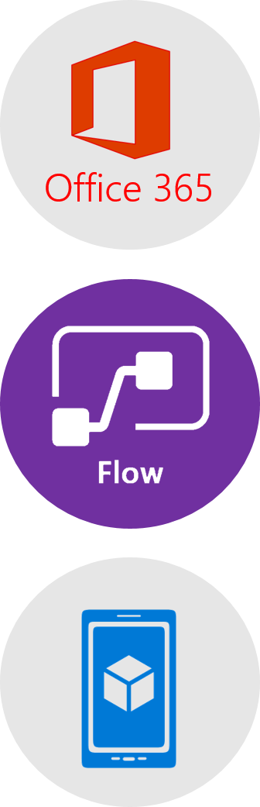
Preferred solution – 11
Extensibility
Business users can create an automated email workflow with Microsoft Flow in 3 easy steps:
Create a new flow that starts with Office 365, on new email with High priority.
Send a push notification action using subject and sender from email.
User would install Microsoft Flow app to receive notifications.
Notes:
This could be implemented with Microsoft Flow.
The business user would login to Microsoft Flow and create a new flow. It would begin with Office 365, on new email, where the priority flag is set to High.
Then a Push notification – send a push notification action would follow that can use the subject and sender of the email in the subject of the notification.
The user would save this flow. To receive notifications, the user would need to install the Microsoft Flow app on her mobile device.

Slide 64


Preferred objection handling
How can we automate our processes?
Will Microsoft Flow replace Logic Apps?
Is there really a way to securely store application secrets in the cloud?
How can we stay on top of a growing API ecosystem?
We won’t have all of the SQL features available to us in the cloud.
Which .NET framework should we choose?
Notes:
https://github.com/microsoft/MCW-App-modernization/blob/master/Whiteboard%20design%20session/WDS%20trainer%20guide%20-%20App%20modernization.md#checklist-of-preferred-objection-handling
* Microsoft Flow allows business users to automate their processes.
* Flow will not replace Logic Apps. Logic Apps represent an “advanced” version of Microsoft Flow, providing support for more developer centric tasks, such as integrating API Apps as custom actions, whereas Flow only provides pre-built actions.
* Azure Key Vault provides a mechanism to store secrets encrypted and securely stored within the confines of specialized hardware called Hardware Security Modules (HSM). * A proof of concept that demonstrates the capabilities of Azure API Management can be put together quickly and can easily be scaled up to create the API Store experience Contoso is looking for.
* It is likely that a feature that was previously built into SQL Server and used from applications directly now runs external to Azure SQL Database in the form of a separate Azure service. Examples include:
Linked servers- are not supported by SQL Server, but cross database read-only querying is possible using elastic database query.
Database Mail- which was used to send email directly from SQL Server is not supported, but there are multiple alternatives (such as using Office 365 and SendGrid) that applications can use to send emails.
SQL Server Agent Jobs- these background processes can usually be migrated to a Web Job (running within an App Service), Azure Functions, or to Cloud Service Worker Role.
Service Broker- numerous alternative messaging options exist in Azure, including Azure Storage Queues and Azure Service Bus Brokered Messaging.

Slide 65
Customer quote
“Microsoft has done a brilliant job with the technology they have put into the cloud. Our Azure-hosted applications are modifiable, interoperable, and secure. We could not be happier running PolicyConnect on Azure.”
Charlene Mathis, General Manager, Contoso, Ltd.

